Slide 1
Flight Testing Small UAVs for Performance Estimation
Adam Chase

Slide 2
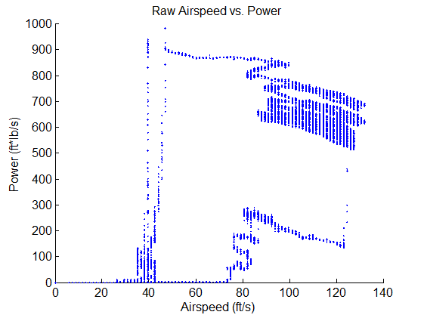
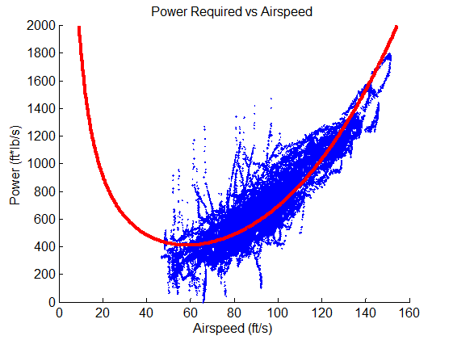
Motivation
Wind tunnel access limited
Full-scale testing often unavailable
Smaller vehicles generally not in steady-level flight
Provide intelligent design decisions based on test flight
Many potential uses for accurate sensing of small UAVs

Slide 3
Thesis Goal
Top level: determine full-scale performance of small R/C aircraft
Drag polar, C_{L} – α curve, etc.
Secondary goal: ensure apparatus can be expanded for other flight test uses
Stability derivatives
Dynamic thrust measurements

Slide 4
Previous Work
Assume dynamics model is known
Wind Field Estimation for Small Unmanned Aerial Vehicles, Langelaan et al. 2010
Assume no wind, or no vertical wind
Angle of Attack and Sideslip Estimation Using an Inertial Reference Platform, Zeis. 1988
Used autopilot to stabilize vehicle
Flight Testing Small, Electric Powered Unmanned Aerial Vehicles, Ostler. 2006
Assume linearization about maneuver
Real-Time Aerodynamic Parameter Estimation Without Air Flow Angle Measurements, Klein and Morelli. 2012
Notes:
These aren’t exclusive. For instance. No wind/no vertical wind needs this assumption OR a dynamics model

Slide 5
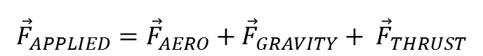
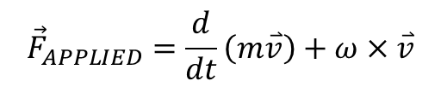
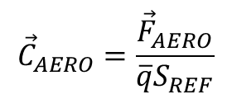
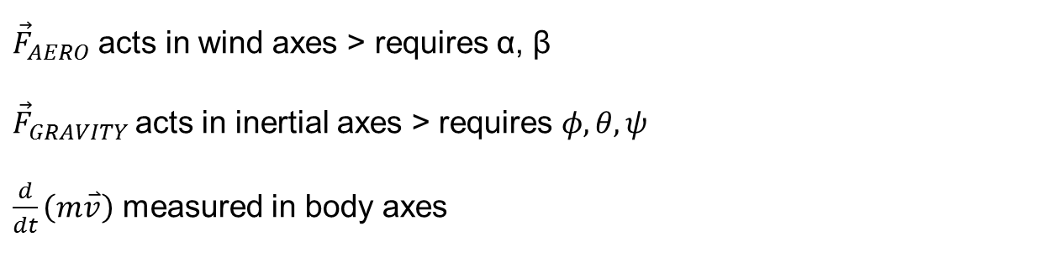
Equations of Motion
$${\vec{F}}_{APPLIED}=\frac{d}{dt}\left(m\overset{⃑}{v}\right)+ω×\overset{⃑}{v}$$
$${\vec{F}}_{APPLIED}={\vec{F}}_{AERO}+{\vec{F}}_{GRAVITY}+ {\vec{F}}_{THRUST}$$
$${\vec{C}}_{AERO}=\frac{{\vec{F}}_{AERO}}{\overline{q}S_{REF}}$$
${\vec{F}}_{AERO}$ acts in wind axes > requires α, β
${\vec{F}}_{GRAVITY}$acts in inertial axes > requires $φ, θ, ψ$
$\frac{d}{dt}\left(m\overset{⃑}{v}\right)$ measured in body axes

Slide 6
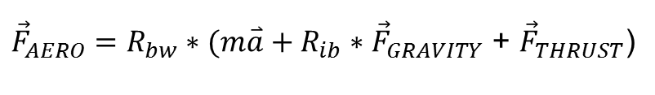
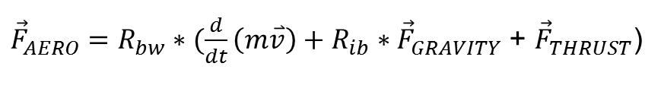
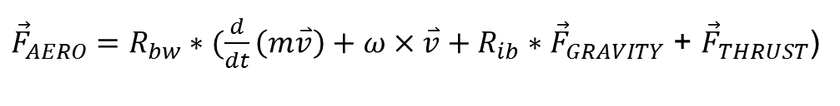
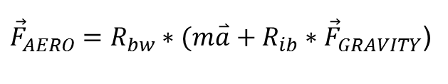
Assumptions
${\vec{F}}_{AERO}=R_{bw}∗(\frac{d}{dt}\left(m\overset{⃑}{v}\right)+ω×\overset{⃑}{v}+R_{ib}∗{\vec{F}}_{GRAVITY}$ + ${\vec{F}}_{THRUST}$)
No Coriolis effect
Fixed mass system
Folding propeller used and turned off for test
${\vec{F}}_{AERO}=R_{bw}∗(\frac{d}{dt}\left(m\overset{⃑}{v}\right)+R_{ib}∗{\vec{F}}_{GRAVITY}$ + ${\vec{F}}_{THRUST}$)
${\vec{F}}_{AERO}=R_{bw}∗(m\overset{⃑}{a}+R_{ib}∗{\vec{F}}_{GRAVITY}$ + ${\vec{F}}_{THRUST}$)
${\vec{F}}_{AERO}=R_{bw}∗(m\overset{⃑}{a}+R_{ib}∗{\vec{F}}_{GRAVITY}$)

Slide 7
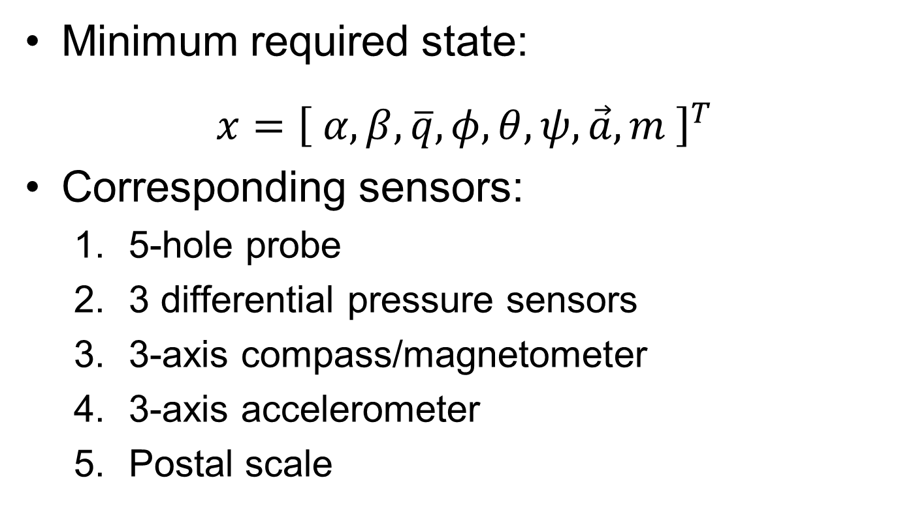
Required Sensors
Minimum required state:
$$x={\left[ α,β,\overline{q},φ,θ,ψ,\vec{a},m \right]}^{T}$$
Corresponding sensors:
5-hole probe
3 differential pressure sensors
3-axis compass/magnetometer
3-axis accelerometer
Postal scale

Slide 8
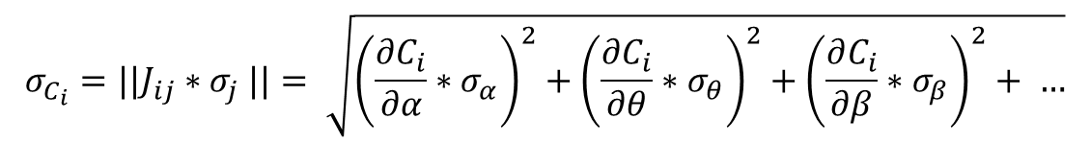
Error Propagation for a Given Point
$$σ_{C_{i}}={||J}_{ij}{∗σ}_{j}||= \sqrt{{\left(\frac{∂C_{i}}{∂α}∗σ_{α}\right)}^{2}+{\left(\frac{∂C_{i}}{∂θ}∗σ_{θ}\right)}^{2}+{\left(\frac{∂C_{i}}{∂β}∗σ_{β}\right)}^{2}+ …}$$
Notes:
Update plot to current sensors and remove fits

Slide 9
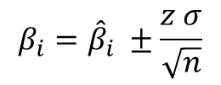
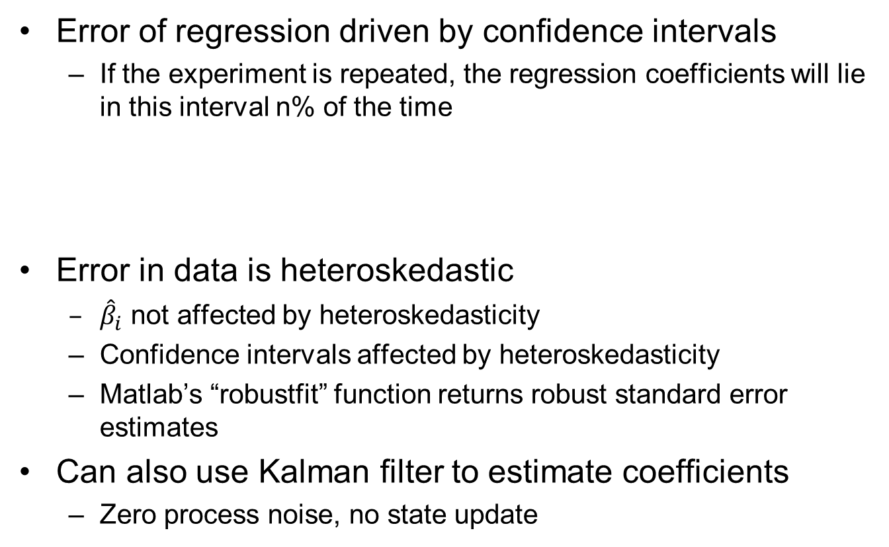
Data Fitting
Error of regression driven by confidence intervals
If the experiment is repeated, the regression coefficients will lie in this interval n% of the time
Error in data is heteroskedastic
${\hat{β}}_{i}$ not affected by heteroskedasticity
Confidence intervals affected by heteroskedasticity
Matlab’s “robustfit” function returns robust standard error estimates
Can also use Kalman filter to estimate coefficients
Zero process noise, no state update
$$β_{i}={\hat{β}}_{i} ±\frac{z σ}{\sqrt{n}}$$
Z = 1.96 for 95% CI

Slide 10
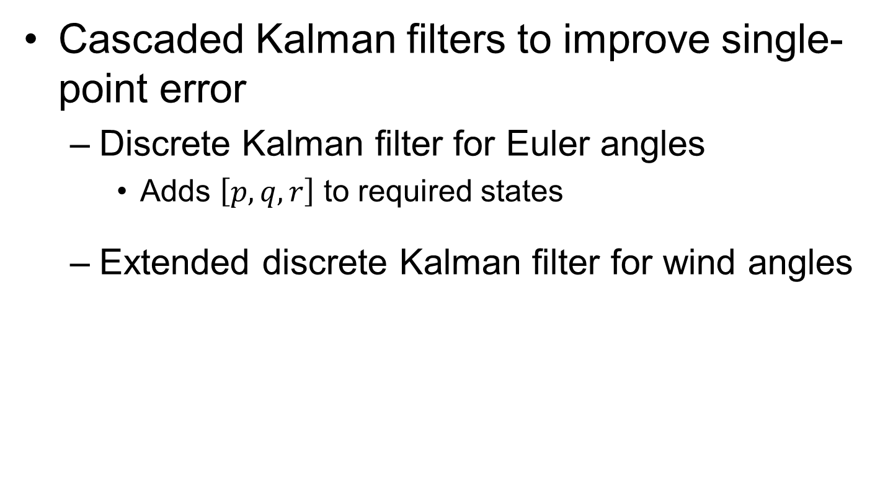
Improving Point Error
Cascaded Kalman filters to improve single-point error
Discrete Kalman filter for Euler angles
Adds $\left[p,q,r\right]$ to required states
Extended discrete Kalman filter for wind angles
$\dot{α}$ $=\frac{1}{V\cos{β}} (−a_{x}\sin{α+a_{z}\cos{α)+q −(p\cos{α+r\sin{α)\tan{β}}}}}$
$$\dot{β}=\frac{1}{V}(−a_{x}\cos{α\sin{β+a_{y}\cos{β−a_{z}\sin{α\sin{β)+p\sin{α −r\cos{α}}}}}}}$$

Slide 11
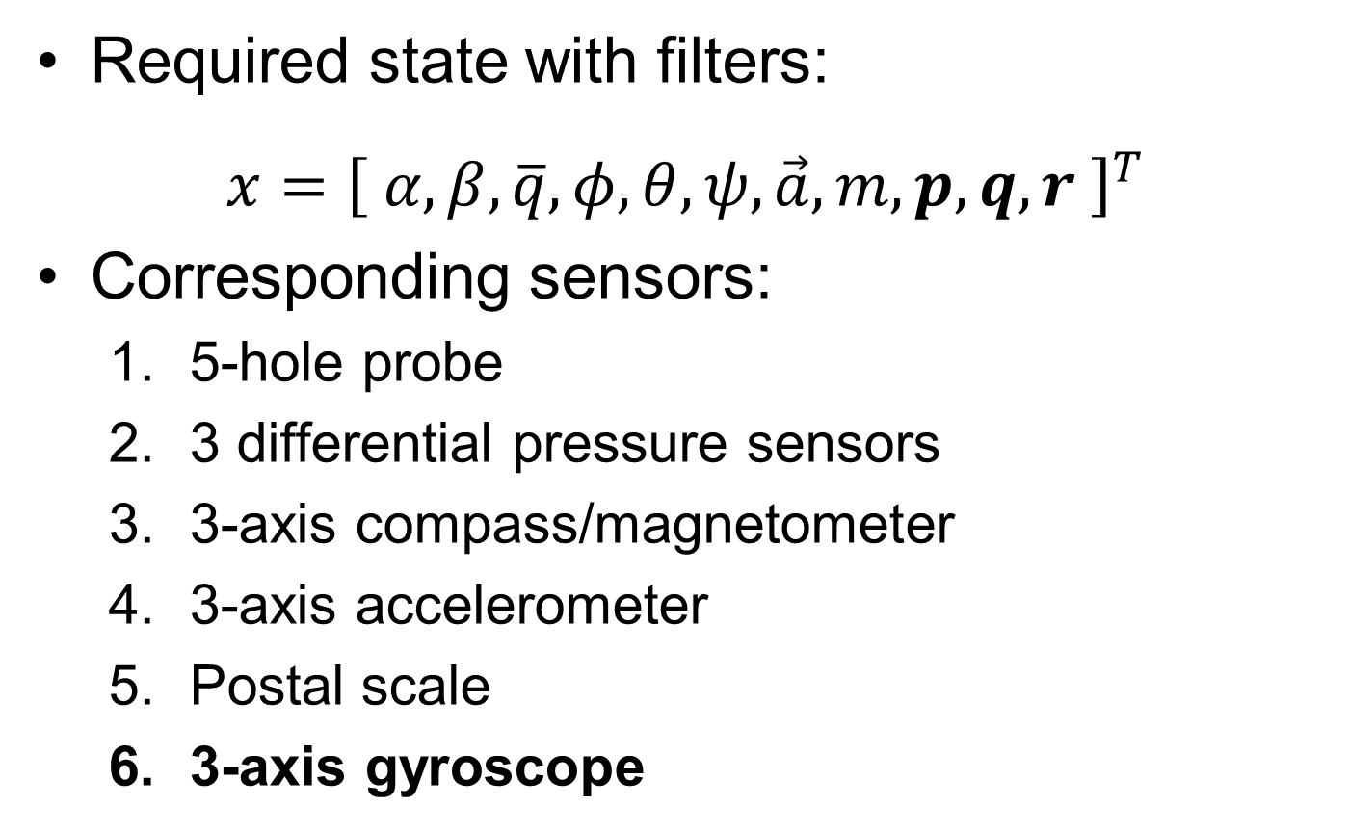
New Required Sensors
Required state with filters:
$$x={\left[ α,β,\overline{q},φ,θ,ψ,\vec{a},m, p,q,r \right]}^{T}$$
Corresponding sensors:
5-hole probe
3 differential pressure sensors
3-axis compass/magnetometer
3-axis accelerometer
Postal scale
3-axis gyroscope

Slide 12
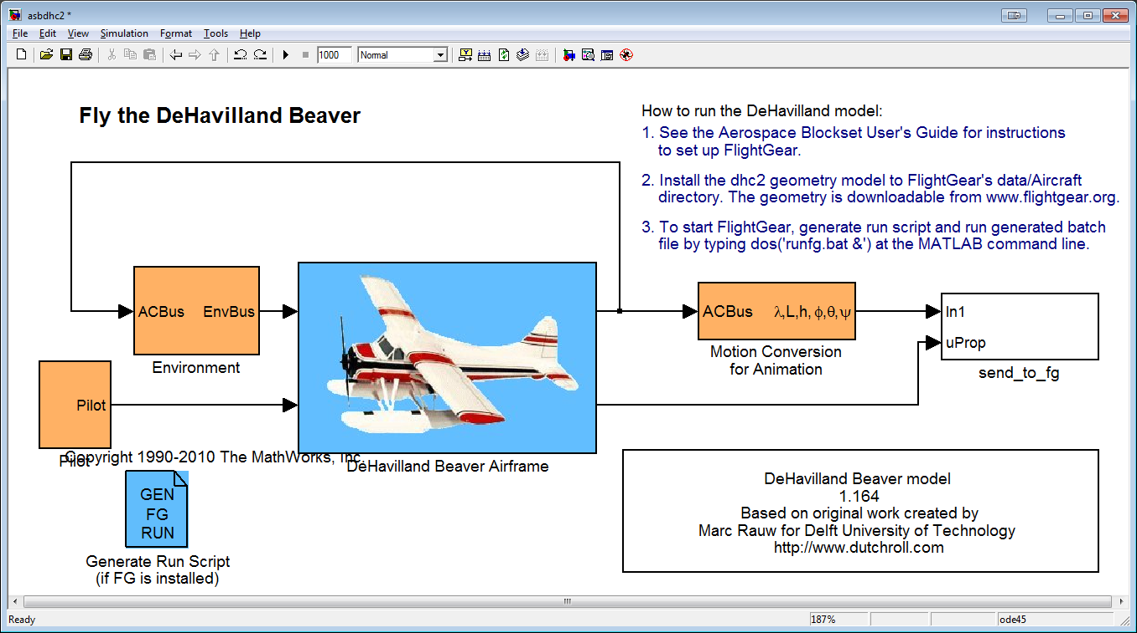
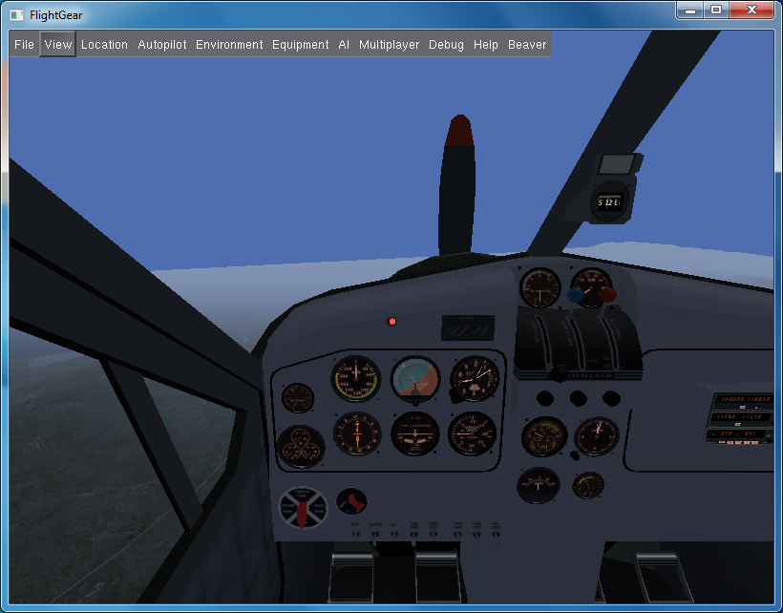
Simulation
Built-in DHC-2 Beaver 6DOF Simulink model
Based on curve fits to flight test data
Non-linear forces and moments
Partially connected to Flight Gear

Slide 13
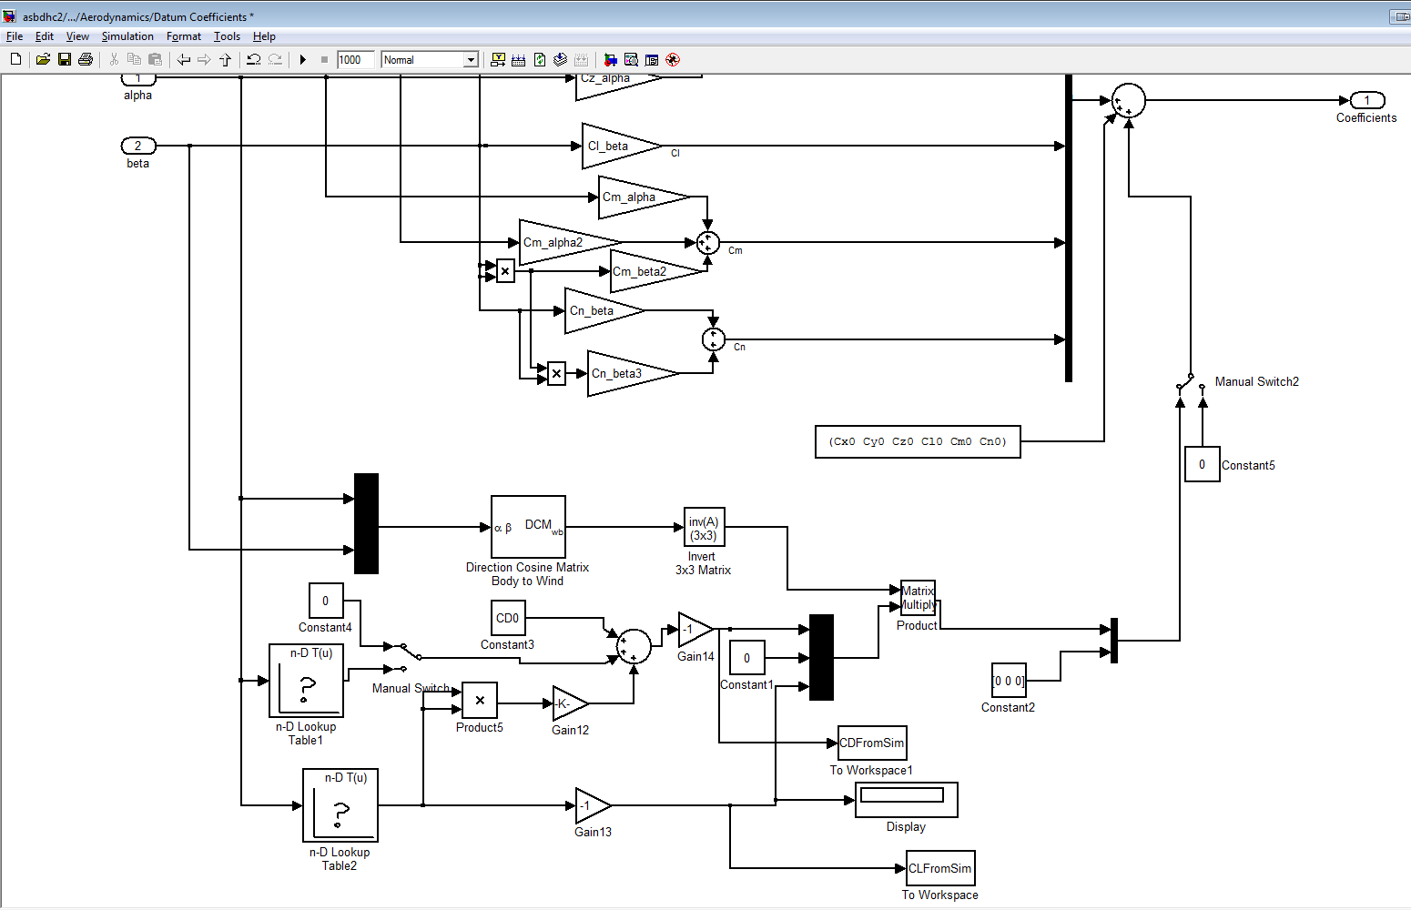
Simulator Modifications
Scaled mass and moments of inertia to R/C aircraft
Replaced aero forces with drag polar
Removed engine forces and moments
Improved Flight Gear visualization
Output required state to workspace for comparison to estimate

Slide 14
Result: No Added Noise
Verified equations of motion match the simulated dynamics

Slide 15
Model Fit with Noise

Slide 16
Accuracy of Model
Actual coefficients [K2 K1 CD0]:
0.0493 0.0000 0.0300
Estimated coefficients :
0.0512 -0.0055 0.0316
Estimated coefficients using 'robustfit' function:
0.0488 -0.0023 0.0310
95.0% CI from 'regress' function :
0.0522/0.0503 -0.0045/-0.0065 0.0320/0.0313
95% CI from 'robustfit' function :
0.0497/0.0480 -0.0014/-0.0032 0.0313/0.0307
Percent error in estimated coefficients:
3.7120 0.5498 5.2035
Percent error in estimated coefficients from 'robustfit':
-1.0104 0.2338 3.1762

Slide 17
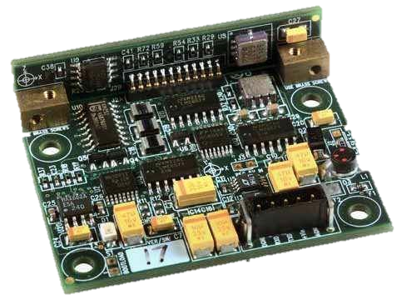
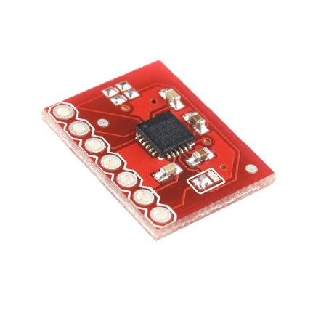
Sensor Selection
Honeywell HMR3500 Compass
0.2º pitch, 0.1º roll
5V board
UART interface
$800
Invense ITG-3200 rate gyro
0.38 º/s - rms
3.3V board
I²C interface
$45
Size:
1.96 x 1.65 x 0.52 inches
Size: 0.7 x 0.55 inches

Slide 18
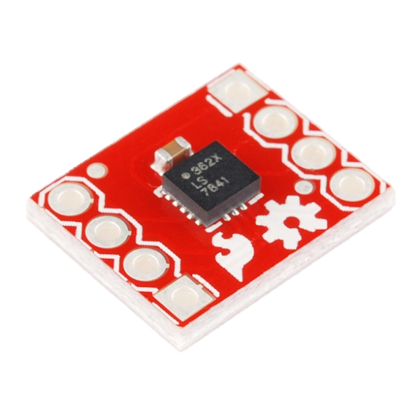
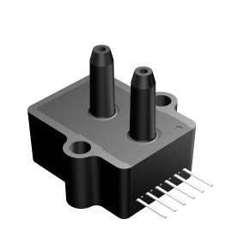
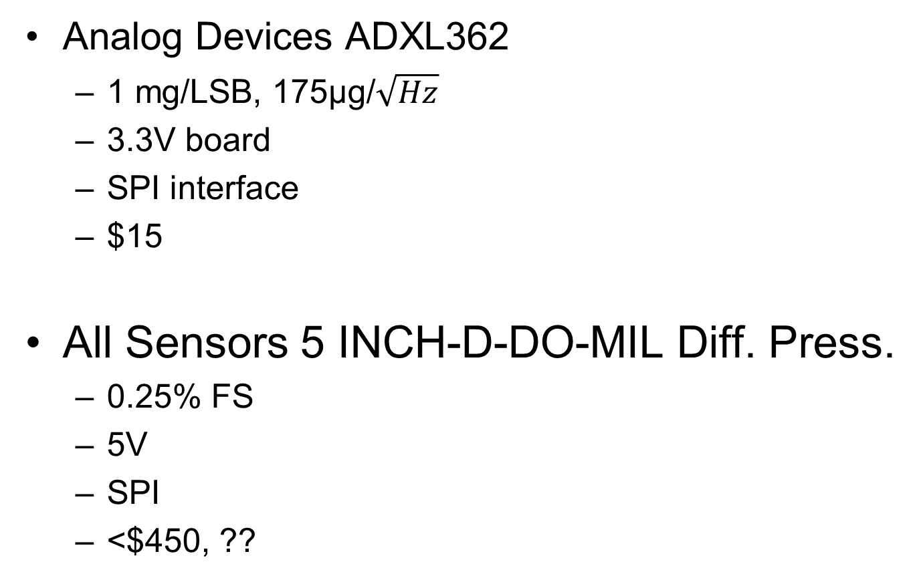
Sensor Selection (cont’d)
Analog Devices ADXL362
1 mg/LSB, 175μg/$\sqrt{Hz}$
3.3V board
SPI interface
$15
All Sensors 5 INCH-D-DO-MIL Diff. Press.
0.25% FS
5V
SPI
<$450, ??
Size: 0.55x 0.6 inches
Size: 1.08 x 1.0 x 1.1 inches

Slide 19
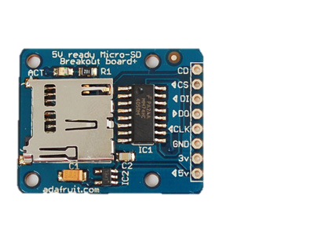
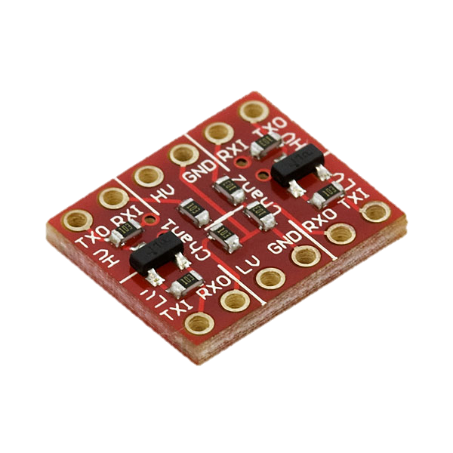
Sensor Selection (cont’d)
adaFruit microSD Card Shield
FAT32 capable
Max 4GB file size
3.3V board
SPI interface
$15
Logic Level Converter
Converts 5V sensors to 3.3V
2 bi-directional channels
$2
Size:
1.25 x 1.0 x 0.15 inches
Size: 0.5 x 0.6 inches

Slide 20
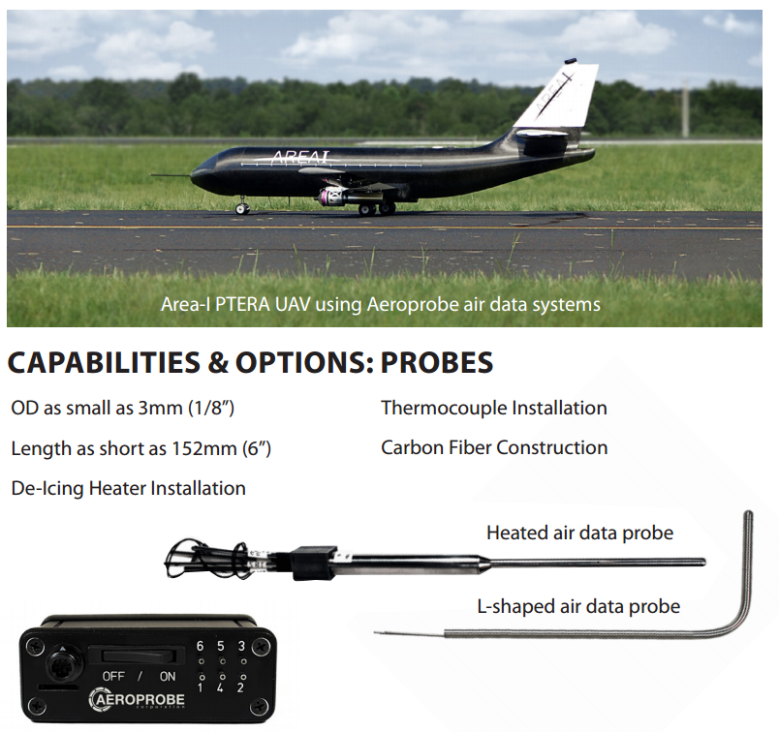
Sensor Selection (cont’d)
Aeroprobe 5 Hole Air Data probe
<1º from mfg
0.2º from A&M
Probe or full
computer
Price : ??
Feedback??

Slide 21
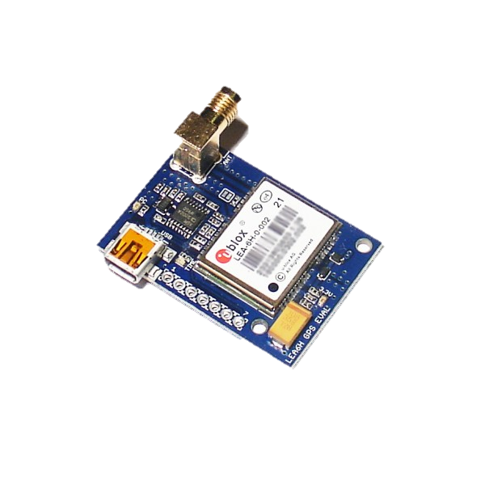
Additional Sensors
uBLOX LEA-6T GPS Receiver
Raw data available
3.3V board
UART,USB,I²C
$150
All Sensors BARO-INHG-DO-MIL Abs. Press.
10 mBar
5V board
SPI
<$450, ??
Size: 1.08 x 1.0 x 1.1 inches

Slide 22
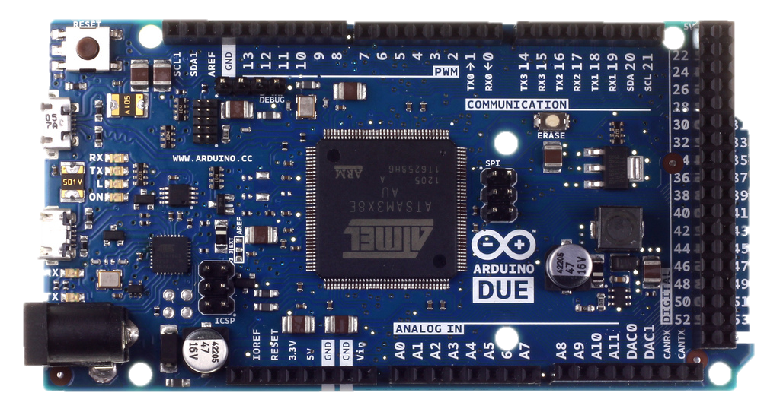
Flight Computer
Arduino Due
32 bit 84 MHz ARM processer
512 Kbytes Flash RAM
54 digital I/O, 12 analog-in (12 bit)
3.3 V I/O pins
4 UART ports
USB Host
7-20V power

Slide 23
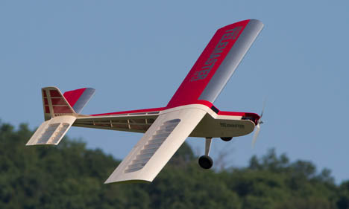
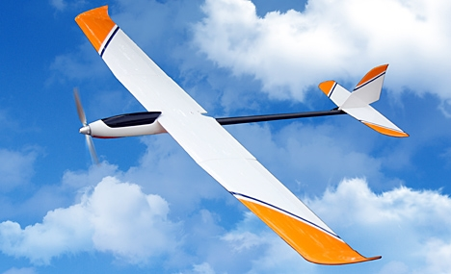
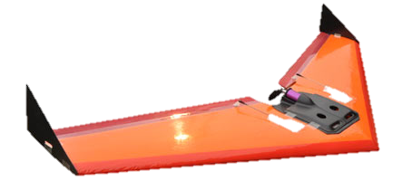
Flight Test Vehicles
0.60 size Telemaster
Motor Glider
Small flying wing

Slide 24
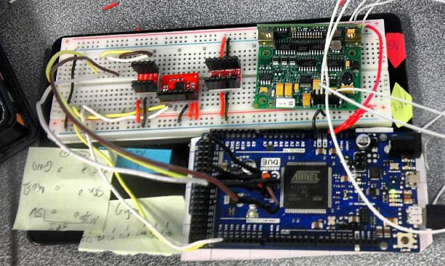
Completed Work
Method developed
Simulated results with nonlinear plant
Added noise and derived sensing requirements
Arduino taking data from gyro to SD card
Data from SD card plotted in MATLAB
Stationary noise estimate from gyro

Slide 25
Work To Be Completed
Task | Estimate (days) | Pessimistic (days)
Sensors fully working | 14 | 28
Board development | 14 | 28
Sensor calibration | 14 | 28
Aircraft integration | 2 | 4
Flight testing | 4 | 8
Data analysis | 2 | 4
Total Time | 50 days ( 7/20/13) | 100 days (9/10/13)

Slide 26
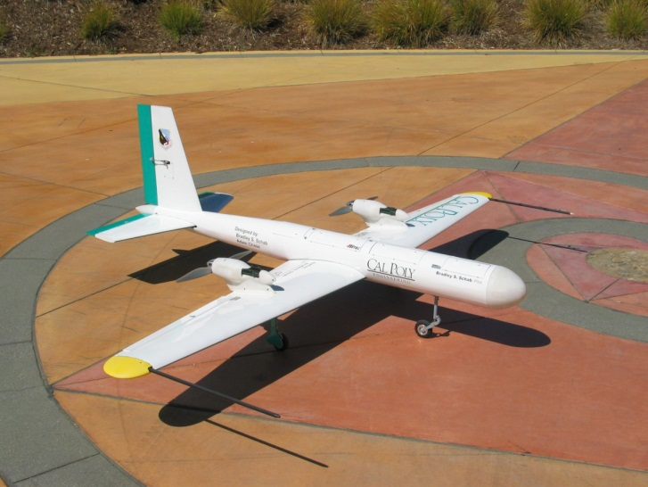
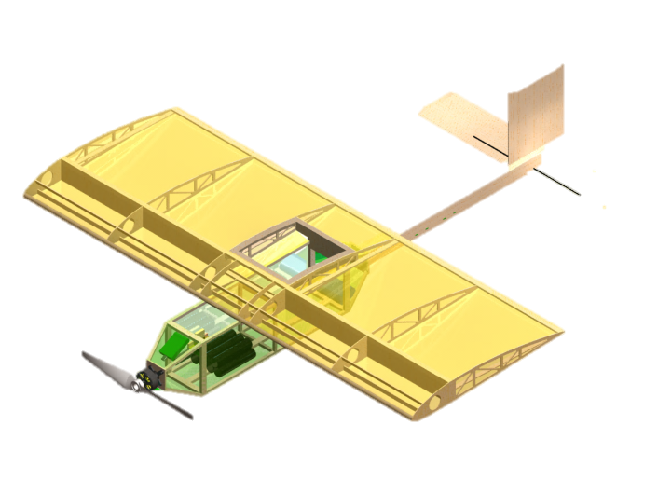
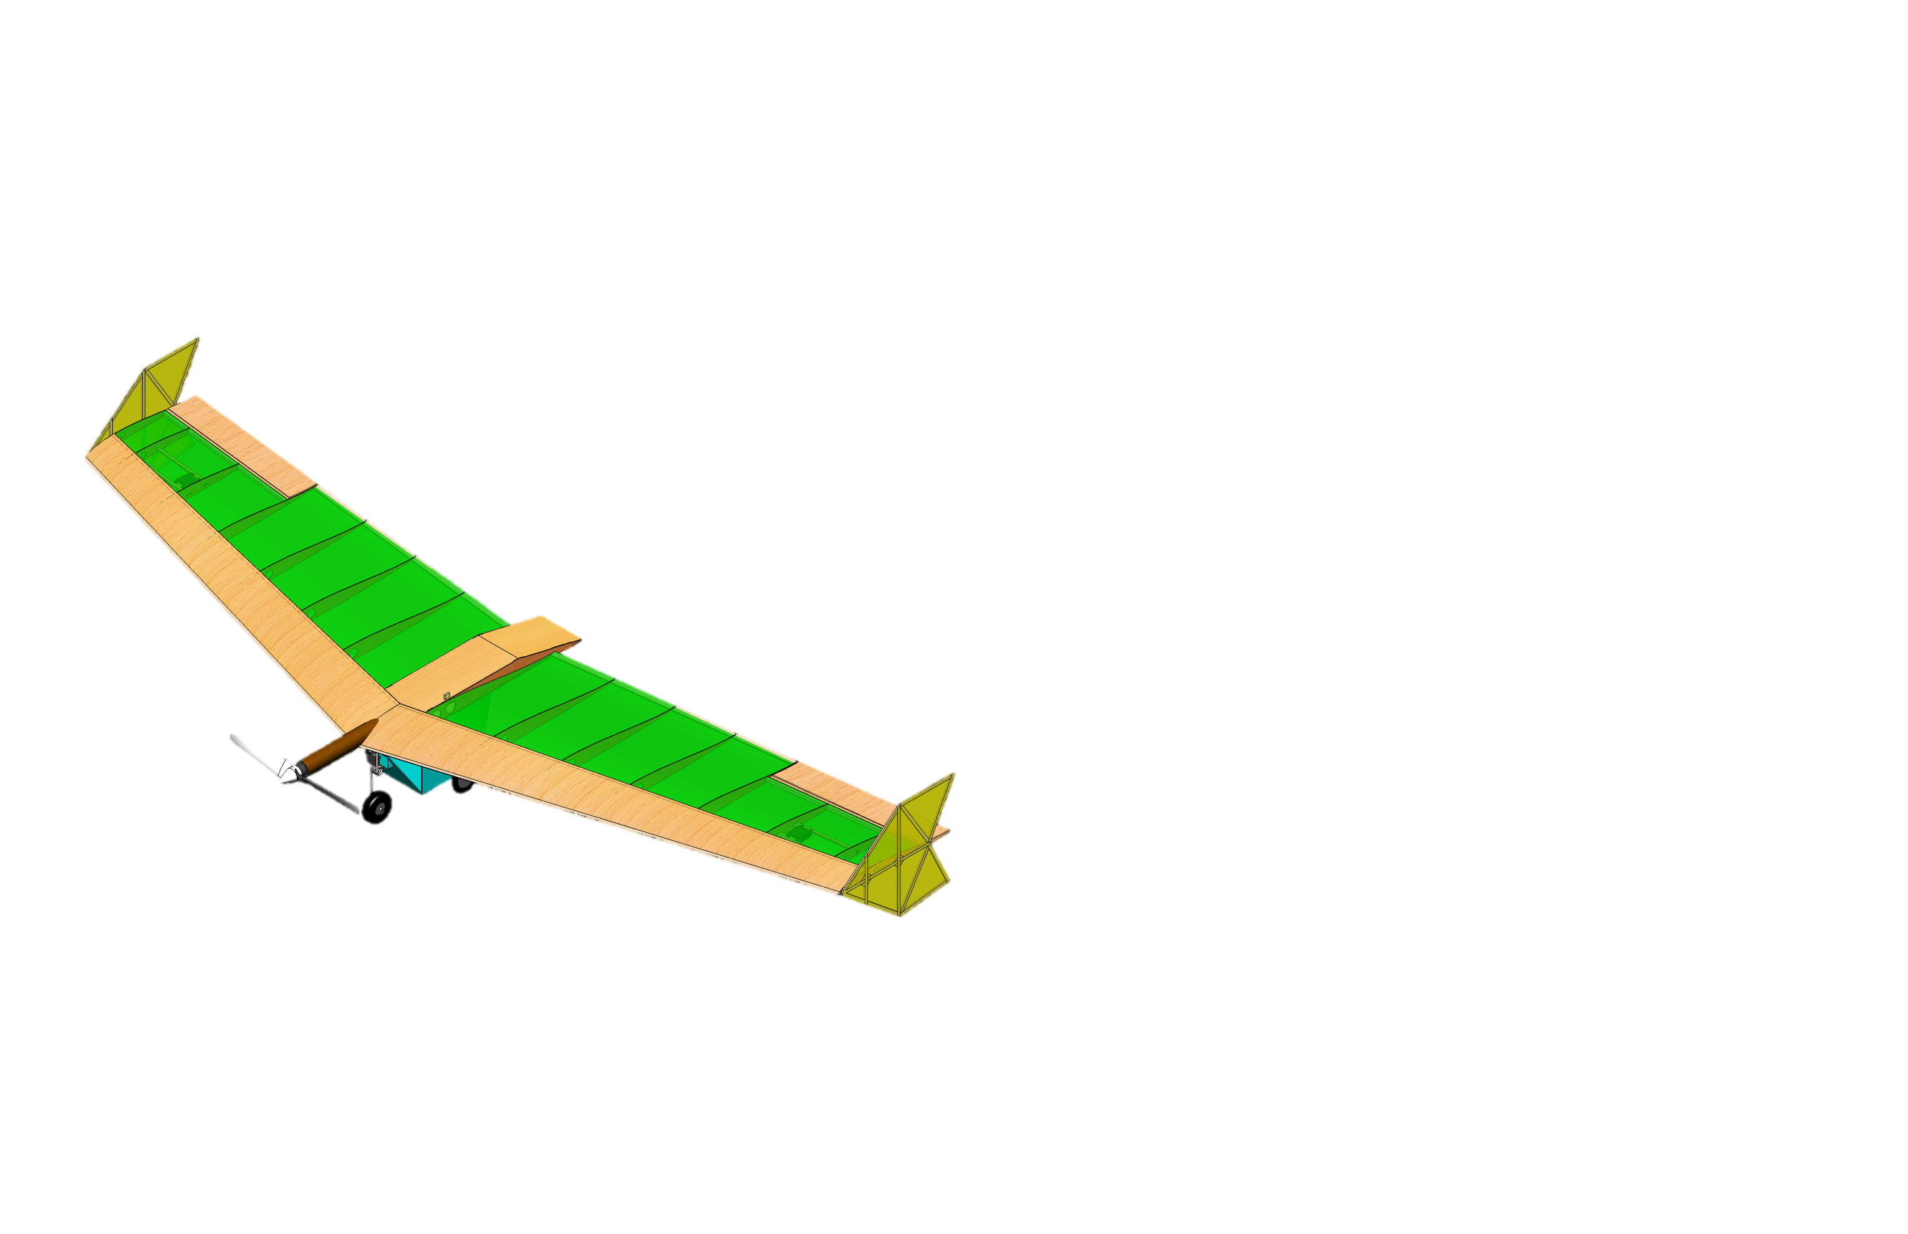
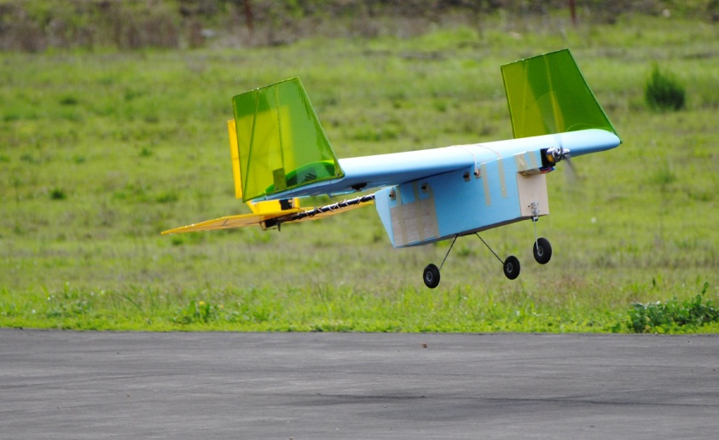
My Experience

Slide 27
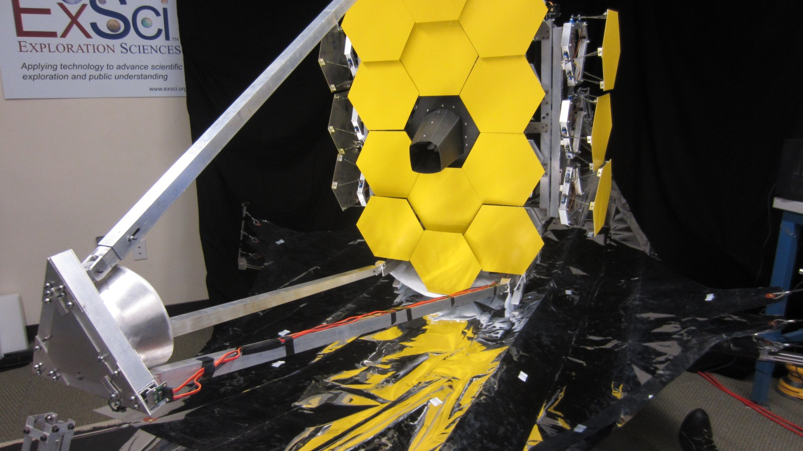
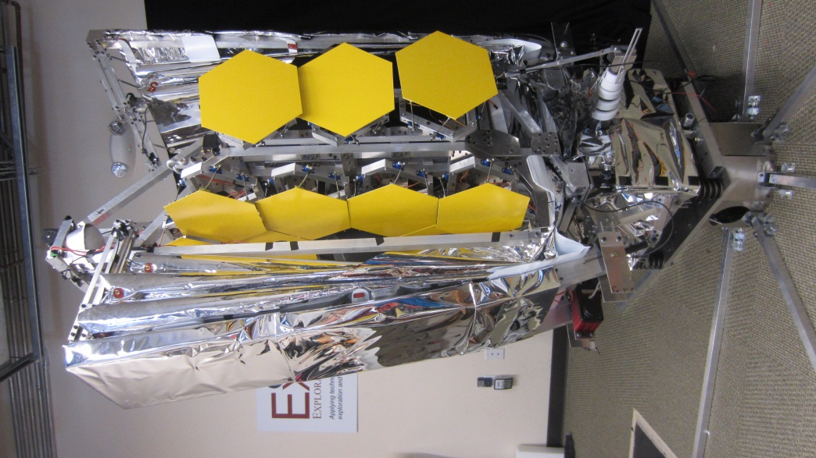
My Experience (cont’d)

Slide 28
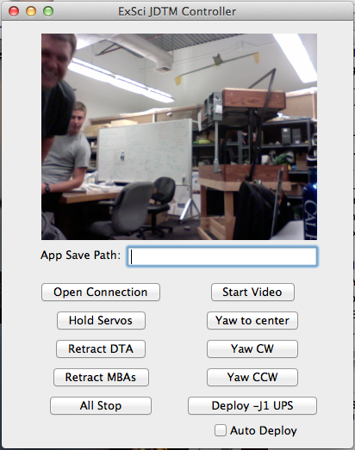
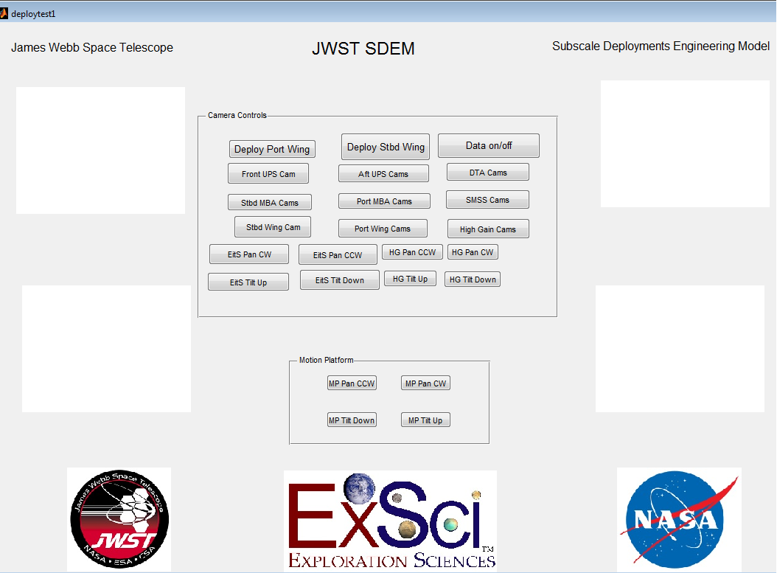
My Experience (cont’d)

Slide 29
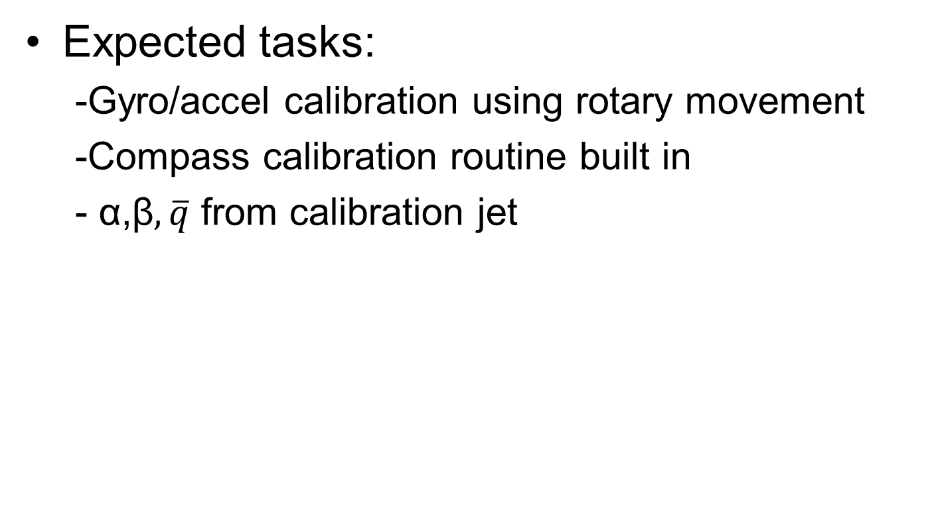
Sensor Calibration
Expected tasks:
-Gyro/accel calibration using rotary movement
-Compass calibration routine built in
- α,β$,\overline{q}$ from calibration jet

Slide 30
Aircraft Integration
Expected tasks:
Re-calibrate sensors once in vehicle
EMI for GPS/Motor/ESC/Compass
Air data integration
Make necessary changes for validation

Slide 31
Flight Testing
Expected tasks:
Flight test planning and documentation
Fairly gentle flight (no loops/rolls)
Add sensing of throttle input to mark beginning of test
Possibly couple with data logging to not overflow file size limit

Slide 32
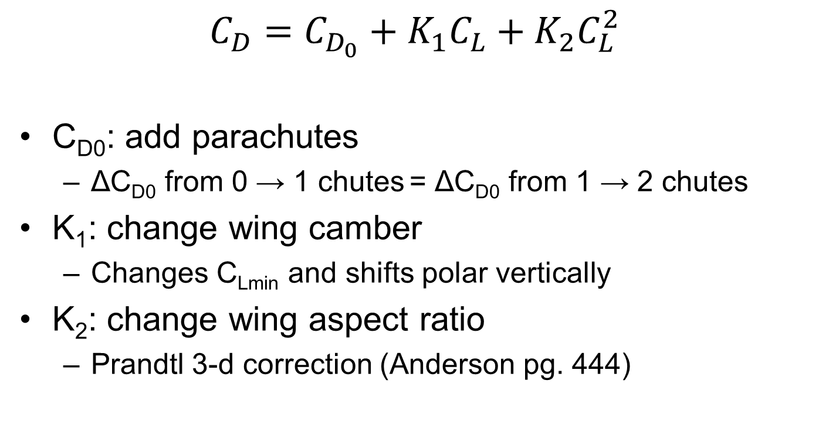
Validation Methods
$$C_{D}=C_{D_{0}}+K_{1}C_{L}+K_{2}C_{L}^{2}$$
C_{D0}: add parachutes
ΔC_{D0} from 0 → 1 chutes = ΔC_{D0} from 1 → 2 chutes
K₁: change wing camber
Changes C_{Lmin} and shifts polar vertically
K₂: change wing aspect ratio
Prandtl 3-d correction (Anderson pg. 444)

Slide 33
Final Product
Integrate accurate data acquisition system into flight vehicle
Measure drag polar and lift curve slope from flight test
Quantify changes in vehicle performance from configuration changes
Notes:
Things we haven’t been able to do in the past

